Slide 1
Research, Manuscript Writing and Scientific Publication
Jim Ayukekbong, BMLS, MSc, Ph.D, CIC
Editor-in-Chief
Devon Metcalf, MSc, PhD, BEdAE, CIC
Associate Editor

Slide 2
Survey of IPAC Canada Members
Shared a survey in the Fall of 2022 related to barriers and facilitators of research and publishing in the field of IPAC
Eight multiple choice questions
Available for two weeks
84 respondents
Will be used to identify supports and resources to help IPAC professionals publish research
67%

Slide 3
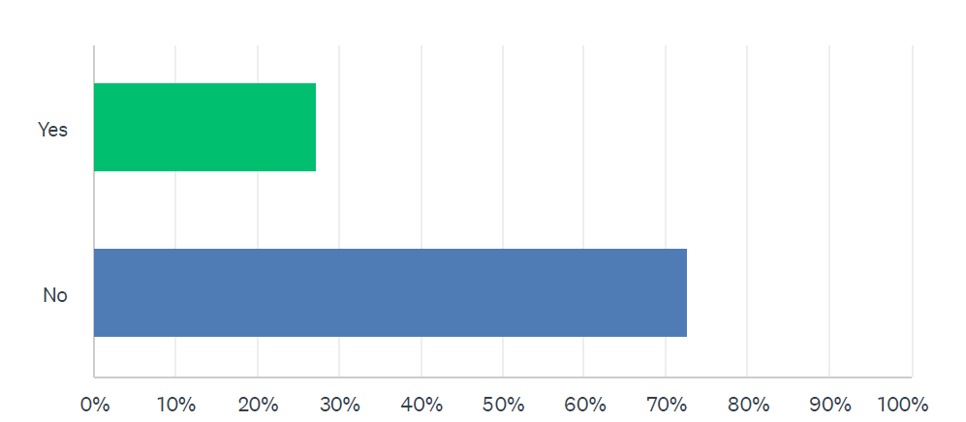
Have you ever submitted an abstract for presentation to the IPAC Canada National Conference or any other scientific conference?
67%

Slide 4
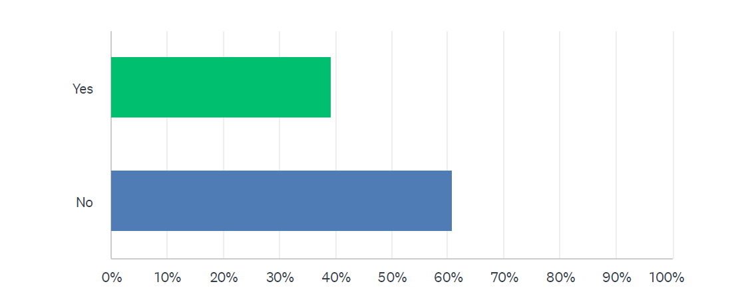
Did you ever develop your abstract into a full manuscript and submit it for publication to a scientific journal?
67%

Slide 5
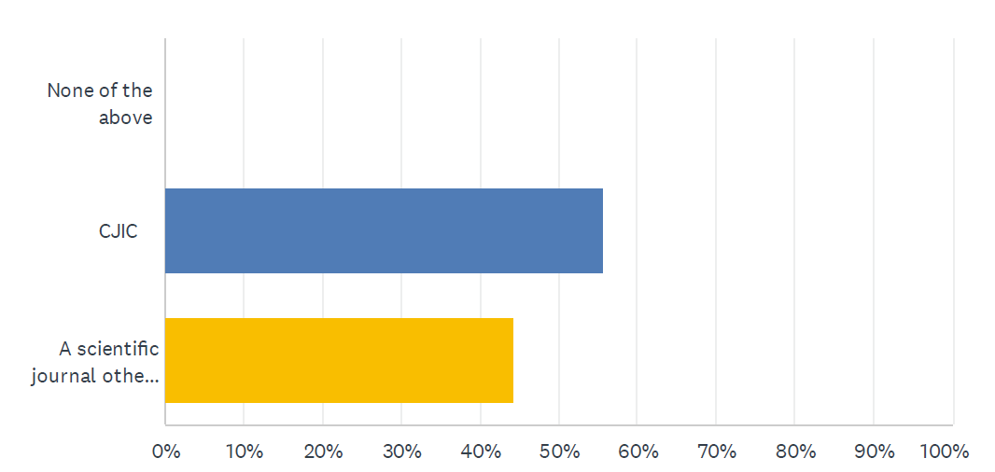
Where did you publish your manuscript?
67%

Slide 6
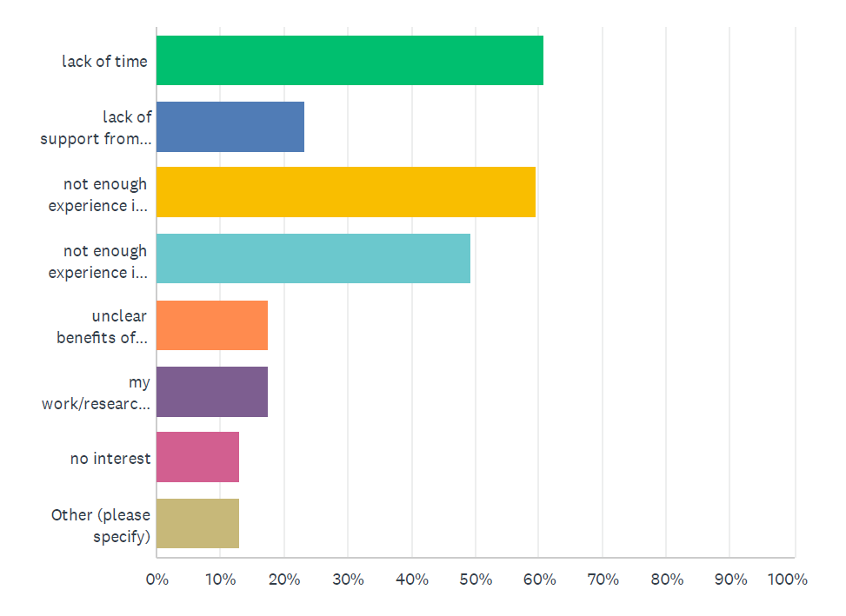
What are the barriers to developing your abstract into a manuscript for publication?
67%

Slide 7
Other Barriers
New to the field of IPAC
Not directly involved in research
Unfamiliar with the process
Unclear benefit
Not participating in work that would be considered “new and insightful”
67%

Slide 8
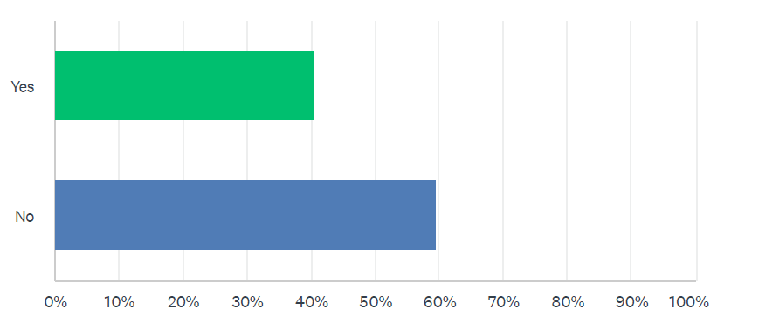
Do you require any support from IPAC Canada in developing an abstract into a manuscript for publication in CJIC?
67%

Slide 9
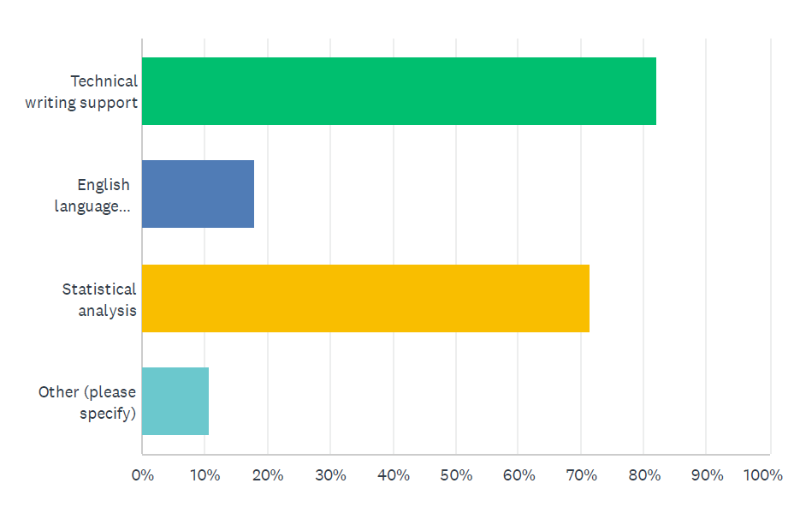
What type of assistance would you require from IPAC Canada?
67%

Slide 10
Other types of assistance
Workshop or series of workshops on manuscript development
Coaching/mentoring in research and writing a manuscript
67%

Slide 11
Existing Resources
PLOS Writing Center
Various resources on writing abstracts, methods, discussions and reporting statistical results
IPAC Canada webinars
Abstract to Manuscript
Tricks and Tips for Abstract Writing
Manuscript Preparation: How to Get Your Paper Published
CJIC resources
Preparing Your Manuscript
Guidelines for Authors
67%

Slide 12
Why Publish?
Answer important IPAC Questions
Challenges you face in your organization
Contribute to patient safety
Issues with a broader IPAC implication
67%

Slide 13
Why Publish?
An important part of your professional development
CIC® recertification
Publications is an Infection Prevention Unit (IPU) category
67%
Source: Certification Board of Infection Control and Epidemiology (CBIC). 2023 https://www.cbic.org/CBIC/Recertify/Recertification-by-Continuing-Education/IPU-Criteria-Chart.htm

Slide 14
67%
Publications is an IPU category
Five Infection Prevention Units (IPUs) per publication
Source: Certification Board of Infection Control and Epidemiology (CBIC). 2023 https://www.cbic.org/CBIC/Recertify/Recertification-by-Continuing-Education/IPU-Criteria-Chart.htm

Slide 15
67%
IPAC Canada. 2022. https://ipac-canada.org/photos/custom/pdf/IPAC_CoreCompetencies_ICPs_2022_revised.pdf

Slide 16
67%
IPAC Canada. 2022. https://ipac-canada.org/photos/custom/pdf/IPAC_CoreCompetencies_ICPs_2022_revised.pdf

Slide 17
IPAC Canada Editorial Award
Annually recognizes a high quality manuscript published in CJIC by IPAC Canada members
Decision made by a panel of editorial board members
Recognition at the IPAC Canada Education Conference
Award consists of either conference registration or a monetary award.
67%

Slide 18
Strategies to overcome barriers
Prioritize skills development
Collaborating with or seeking mentorship from an experienced colleague
Start small
Engage leadership for support
67%

Slide 19
Why Conduct research?
Curiosity
To understand a phenomenon.
To test existing theories or develop new theories on the basis of existing ones.
Contribute in forming new knowledge or expand the existing knowledge base.
67%

Slide 20
Research process
Step 1: Determine a suitable research project
Step 2: Establish collaboration
Step 3: Write the research proposal
Step 4: Apply for funding
Step 5: Perform the study
Step 6: Write your manuscript
Step 7: Publish your findings
67%

Slide 21
Step 1: Determine a suitable research project
infection prevention/control strategies
healthcare-associated infections
surveillance and outbreak management
vaccine-preventable diseases
infection control programs
antimicrobial resistance
hand hygiene
transmission-based precautions
personal protective equipment use
cleaning and disinfection
IPAC education
QI in IPAC
emerging technologies
67%

Slide 22
Step 2: Establish collaboration

Slide 23
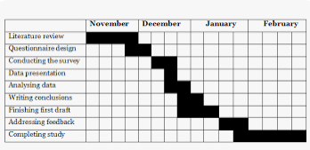
Step 3: Writing of a research proposal
Novelty of the study/Importance
Feasibility of the study/time frame
Scope of the study
Solid research methodology
Availability of applicable assays
67%

Slide 24
Step 4: Apply for funding
Internal – Within your institution
External – Leverage collaboration with external partners
Provincial/Federal
Canada Foundation for Innovation (CFI)
Canadian Institutes of Health Research (CIHR)
Natural Science and Engineering Research (NSER)
Social Sciences and Humanities Research (SSHRC)
Genome Canada
Public Health Agency of Canada (PHAC)
Natural Sciences and Engineering Research Council of Canada (NSERC)
Networks of Centres of Excellence of Canada (NCE)
Healthcare Excellence Canada (HEC)
67%

Slide 25
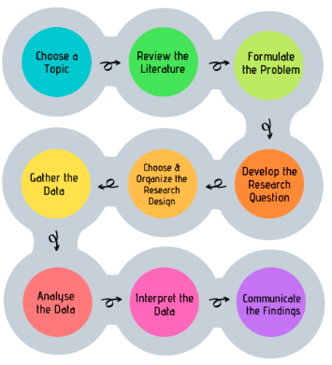
Step 5: Performing the study
67%

Slide 26
Step 6: Writing your manuscript
Types of articles
Original research | Structured abstract (max. 300 words), text (max. 3,000 words), tables and figures (max. 5 combined), and references (max. 40)
Concise report | Narrative abstract (max. 100 words), text (max. 1,200 words), tables or figures (max. 2 combined), and references (max. 10)
Review article | Structured abstract (max. 300 words), text (max. 3,000 words), tables and figures (max. 5 combined), and references (max. 40)
Outbreak investigation | Narrative abstract (max. 200 words), text (max. 2,000 words), tables or figures (max. 3 combined), and references (max. 20)
Quality Improvement | Structured abstract (max. 300 words), text (max. 2,500 words), tables and figures (max. 4 combined), and references (max. 40)
IPAC Practice | Narrative abstract (max. 100 words), text (max. 1,200 words), tables or figures (max. 2 combined), and references whenever appropriate (max. 10)
Emerging technologies | Abstract (unstructured acceptable; max. 300 words), text (max. 2,500 words), tables and figures (max. 4 combined), and references (max. 40)
Letter to the editor | Text (max. 900 words), tables or figures (max. 2 combined), and references (max. 10)
67%

Slide 27
Preparing your manuscript
Read instructions to authors
Title page
Abstract
Word count
Full article formatting
Referencing
Cover letter (why should your manuscript be accepted)
67%

Slide 28
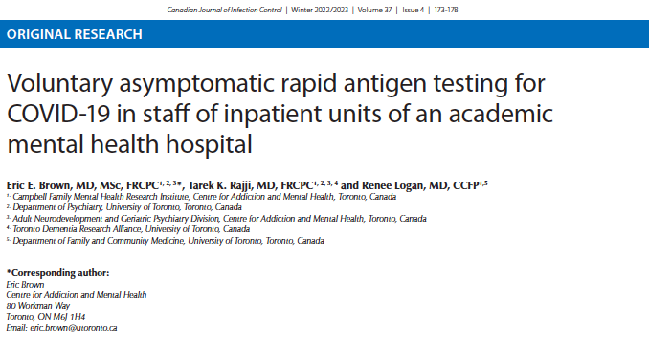
Title page
Title
Authors and affiliation
Corresponding author
Key words
Acknowledgement
Conflict of interest
67%

Slide 29
Abstract
Summary of the entire work
May be structural or non-structural
Should include a brief summary of the main manuscript text:
Background
methods
Results
Conclusion
Adhere to word limit
67%

Slide 30
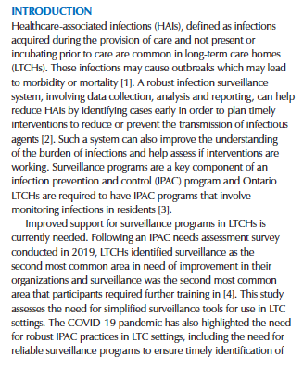
Introduction
State the problem
What is known in the field
State your research question
Why is your research necessary
Aim
Avoid plagiarism
Include references
67%

Slide 31
Methods
1. Participants/population
- Recruitment, screening, inclusion & exclusion criteria
2. Study design
Location, timeline,
Assessments/interventions
Outcome variables
3. Statistical analysis
Samples size and power estimate
Tests, hypothesis and significance level
Your methodology must be explained clearly such that it could be reproduced by someone with similar expertise in your field
67%

Slide 32
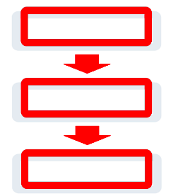
Results
State your findings clearly
Results have to be chronological
Avoid mitigation of results
Do not interpret results
Figures/Tables (cite all figures and tables)
67%

Slide 33
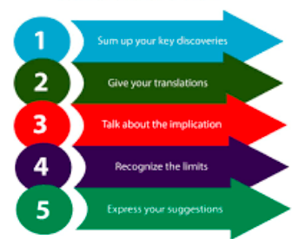
Discussion
Discuss your results in relation to previous knowledge in the field
Explain possible discrepancies
Highlight the strength of your research
State any weaknesses or limitations
Avoid exaggeration and speculations
67%

Slide 34
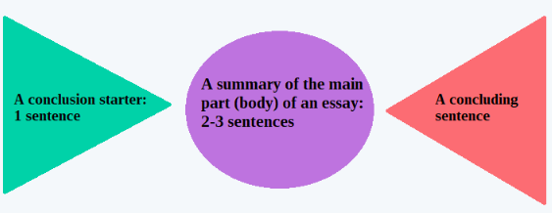
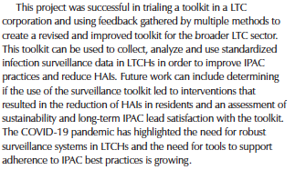
Conclusion
State clearly the IPAC/public health significance of your major finding
Convey the larger implications of your study
Introduce possible new ways of thinking about the research problem (opportunity for future research).
"take-home" message in the form of a strong, succinct statement that you want readers to remember about your study”
67%

Slide 35
Acknowledgment
Acknowledge those who contributed to your work but who do not qualify for authorship
State their contribution(s)
Avoid personal acknowledment e.g.,spouse, boyfriend, girlfriend etc

Slide 36
References
Provide a concise list of all references cited in the text
Use Endnote
CJIC style is APA
67%
Ayukekbong, J. (2021). Public health and human rights during a pandemic; an unresolved dilemma concerning mandatory vaccination against COVID-19 for healthcare workers. Canadian Journal of Infection Control, 36(2):74-76.

Slide 37
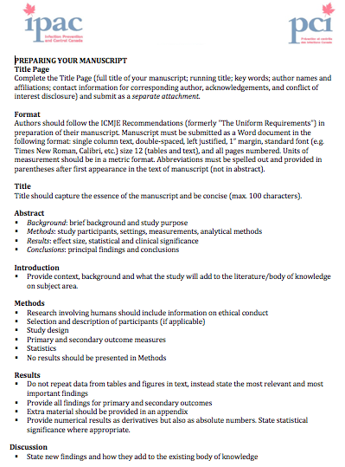
Step 7: Publish your findings
Before submission
Review guidelines for Authors
Have all authors review, provide feedback and sign off
67%

Slide 38
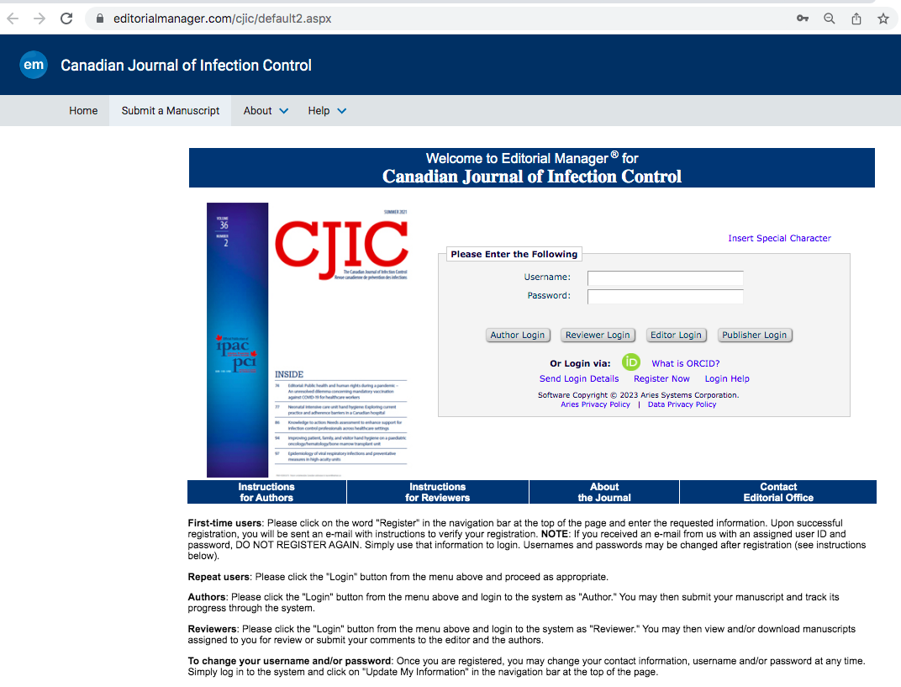
Submission
Submit through our Editorial Manager
67%

Slide 39
What happen after submission
Editor-in-chief reviews and makes a decision where to reject or accept to move forward
Two reviewers are invited to review
Double-blind review
- Editorial board members are blinded to the authors identities
- Authors do not know the identities of the reviewers
- Reviewers provide feedback on the suitability of the paper
- Timeline: 4-6 weeks
67%

Slide 40
Possible decisions
Accept
Reject
Revise
- Manuscripts sent back to authors to address reviewers comments
67%

Slide 41
After acceptance
Submitted to publisher for copyediting
Proof send to authors again for final review
Verification that publication agreement was signed by all authors.
67%

Slide 42
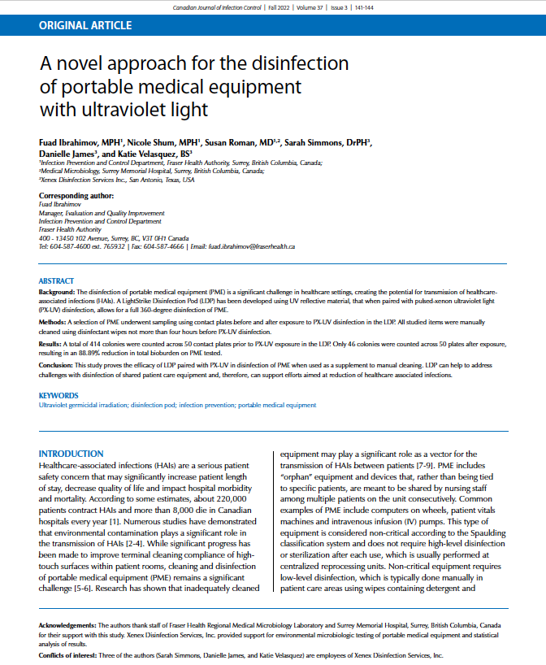
Publication

Slide 43
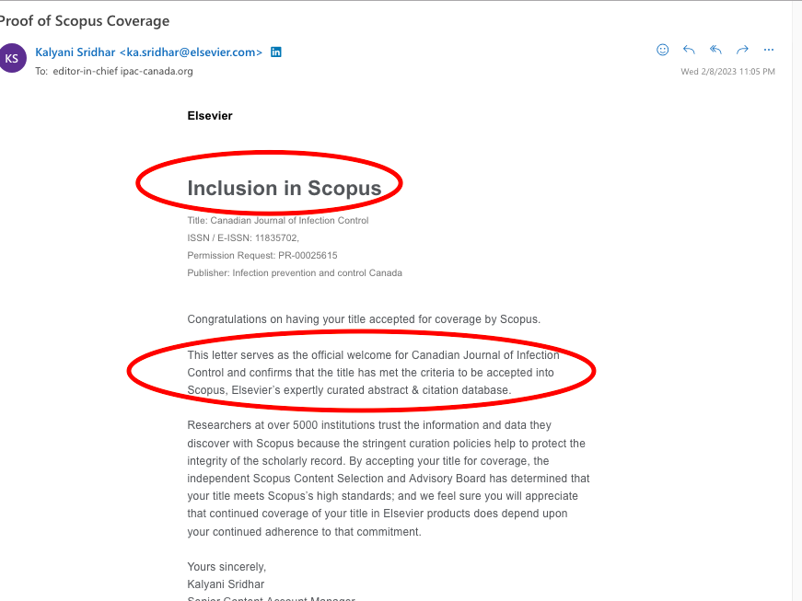
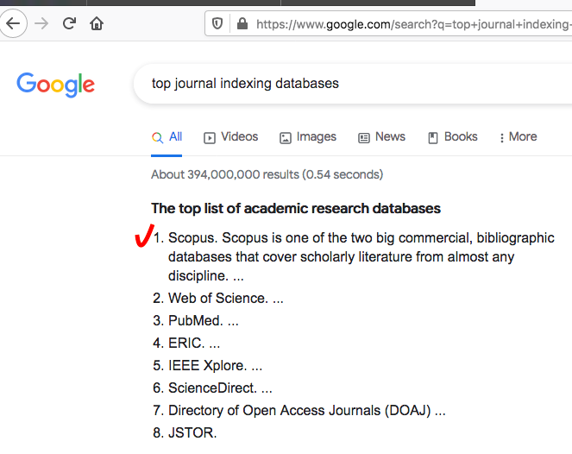
Indexation/Citation
CJIC is now indexed in SCOPUS

Slide 44
Jim Ayukekbong (Editor-in-Chief) editor-in-chief@ipac-canada.org
Devon Metcalf (Associate Editor) associate-editor@ipac.canada.org

